Slide 1

Penn Liberty Motors
Security Options

Slide 2
Car Alarms
Audible Sounds
Door Lock Activators
Parking Light Flash
Remote Panic Button (Optional)
Starter Disable Protection (Optional)

Slide 3
Keyless Entry
Anti-Theft
Remotely Lock/Unlock Doors
Remotely Lock/Unlock Trunk
Remote Started (Optional)
Car Finder (Optional)

Slide 4

Remote Starters
Works up to 2500 feet away
Works in below freezing weather
Programmable

Slide 5
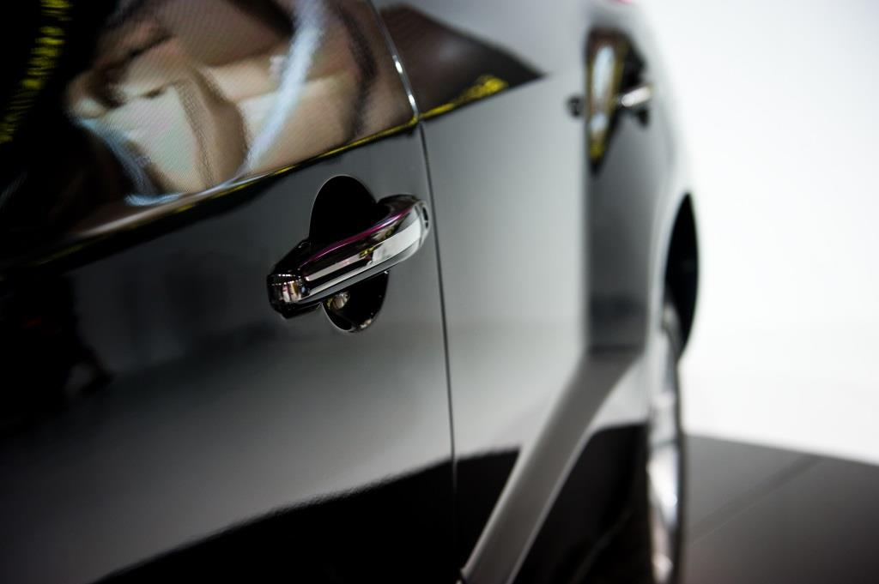
Conversions Kits
Power door locks
Keyless entry

Slide 6

Alarm Sensors
Motion Sensors
Glass Break Sensors

Slide 7

Motorcycle Alarms
Starter disable protection
Ignition tamper sensor
Flashing lights
Warning LED
Piercing siren

Slide 8
Extras
Remote Control Courtesy Lighting
Passenger Unlock Output
Fuel Supply Disable Projection
Horn Output
LCD Paging Remote Control

Slide 9

Silent Alarm
Radio Signal
Tracking Signal
Alerts Police

